Slide 1
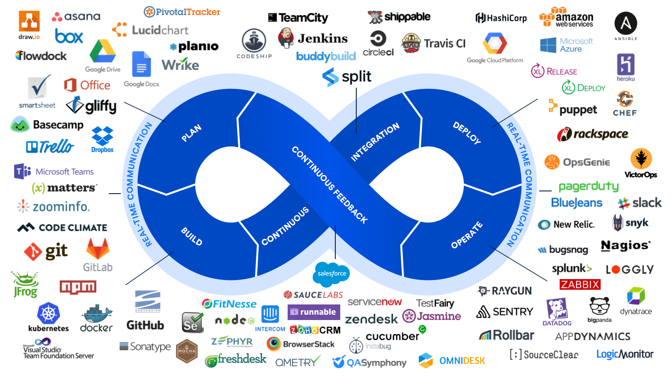

DevOps
What you should know

Slide 2





AGENDA
INTRODUCTION
THE PROBLEM
DEVOPS
HOW TO
QUESTIONS

Slide 3

git clone git@github.com:jonathan-perez-bcs/devops_workshop.git
Or
git clone https://github.com/jonathan-perez-bcs/devops_workshop.git
www.bcstechnology.com.au
Notes:
Production Environment Components

Slide 4
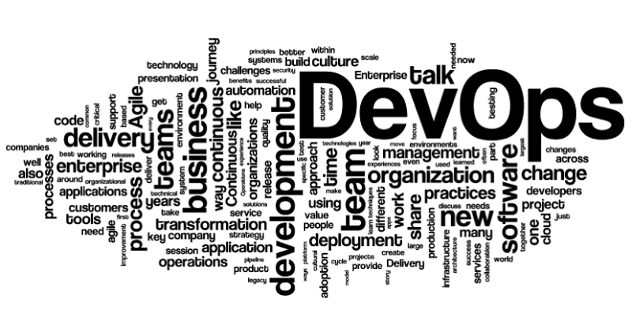
What is DevOps?

Slide 5
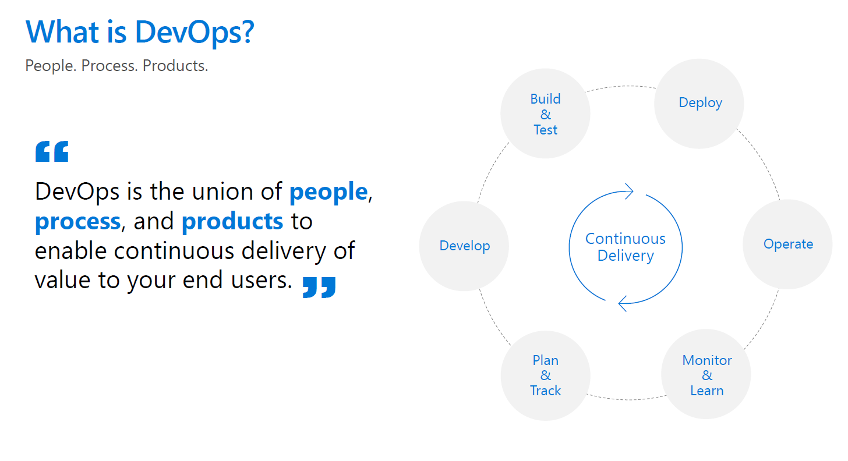
DevOps = a set of practices that combines
software development (DEV) and
Information technology operations (OPS)
to shorten the software development
Lifecycle and provide continuous
Delivery with high software quality
Notes:
Original definition

Slide 6
Notes:
Evolved definition

Slide 7
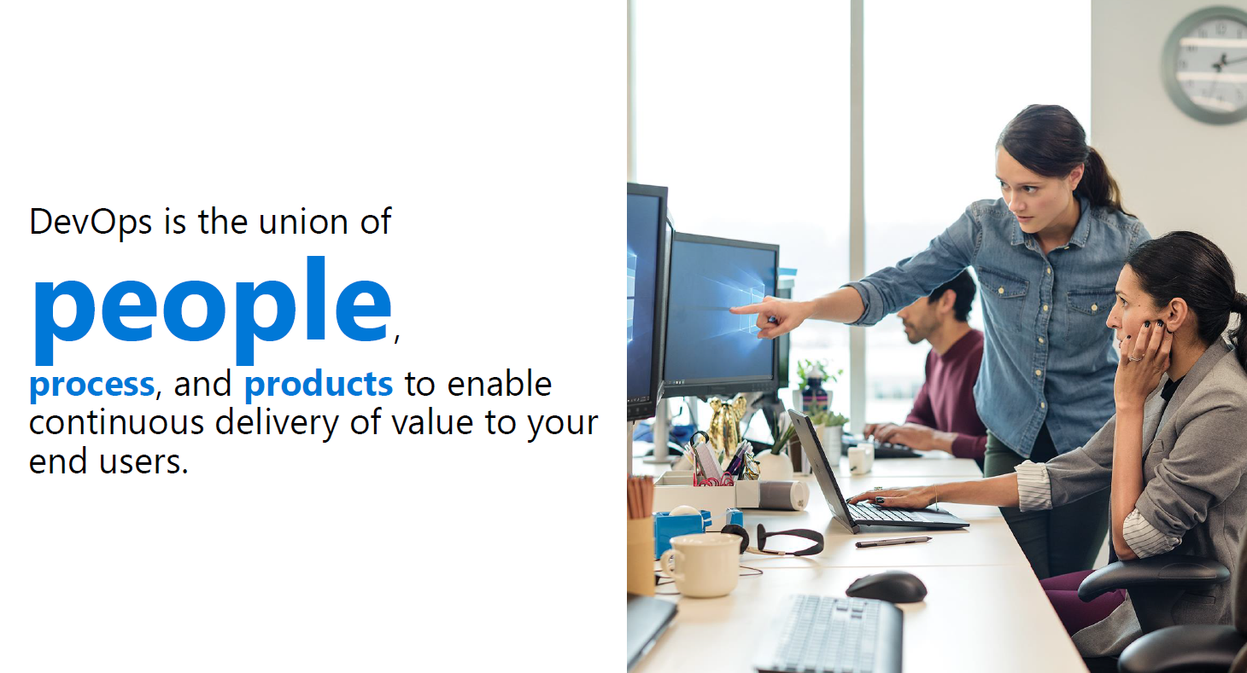

Slide 8
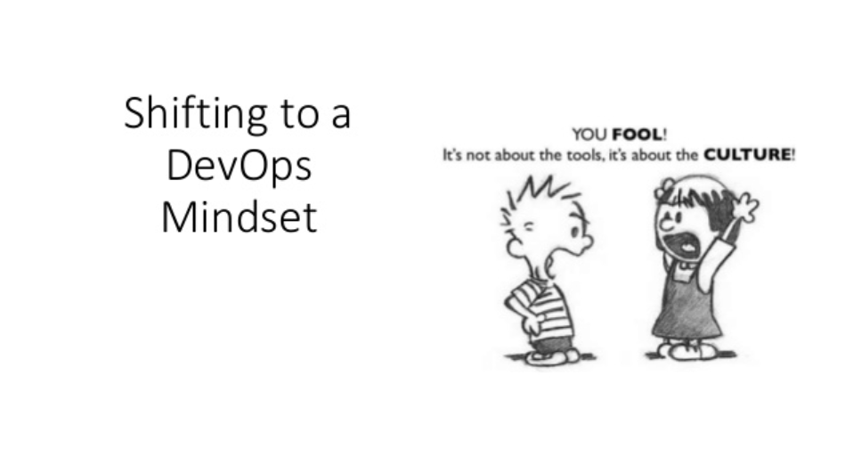

Slide 9
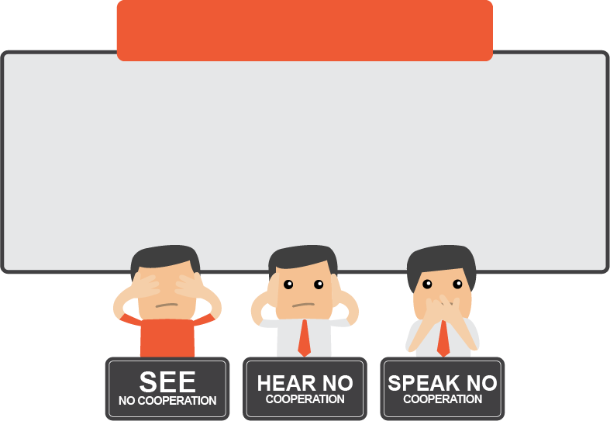
But it was not so simple…
Software Development: "Can you please tell us where it could have gone wrong?"
WebOps: "How should I know? It's your code! Duh."
Compliance holds up a release because of serious control breaches. Call center operators are also flooded with complaints about the reliability of a new mobile app.
IT Operations insist that every production change go through a rigorous change management process.
www.bcstechnology.com.au
Notes:
Production Environment Components

Slide 10
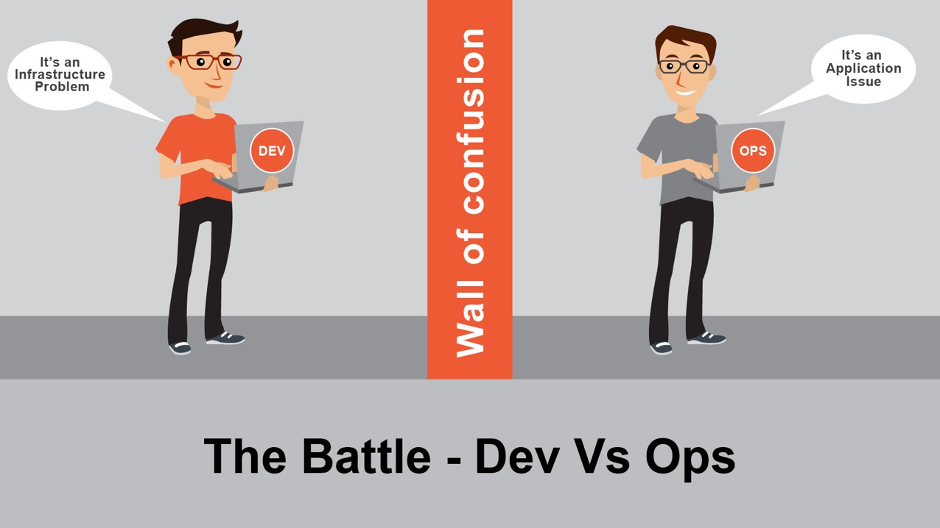

Pain Points
www.bcstechnology.com.au

Slide 11
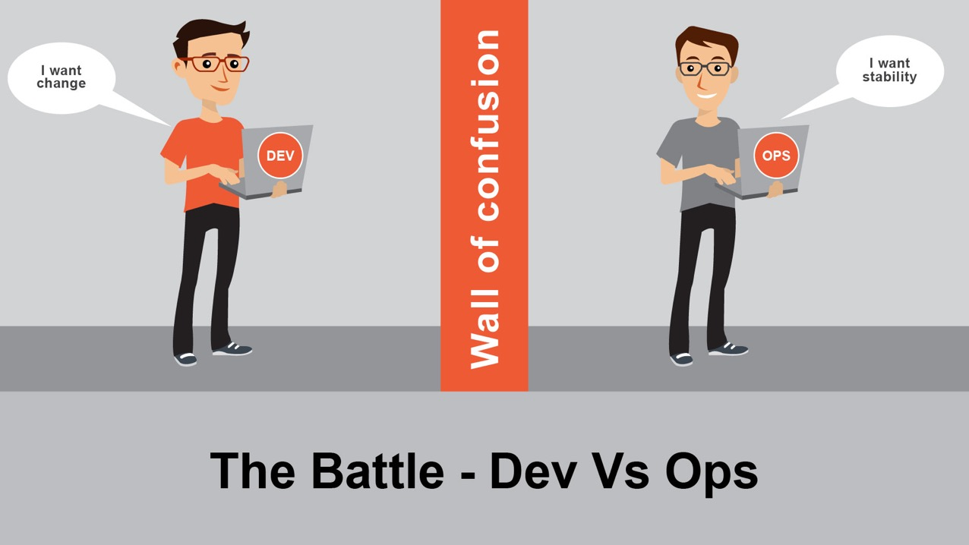
Pain Points
www.bcstechnology.com.au
Notes:
This difference of objectives between developers and operators is called the wall of confusion. We’ll see later precisely what that means any why I consider this something big and bad.
DevOps is a methodology presenting a set of principles and practices (tools are derived from these practices) aimed at having both these personas working towards an unified and common objective : deliver as much value as possible for the company.
Mostly for historical reasons (operators come from the hardware and telco business most often), operators are not attached to the same branch than developers. Developers belong to R&D while operators most of the time belong to Infrastructure department (or dedicated operation department).
In addition, and as a sidenote, these both teams sometimes even run on different budget. The development team uses the build budget while the operation team uses the run budget. These different budgets and the increasing needs to control and shorten the costs of IT in corporation tend to emphasize the opposition of objectives of the different teams.

Slide 12
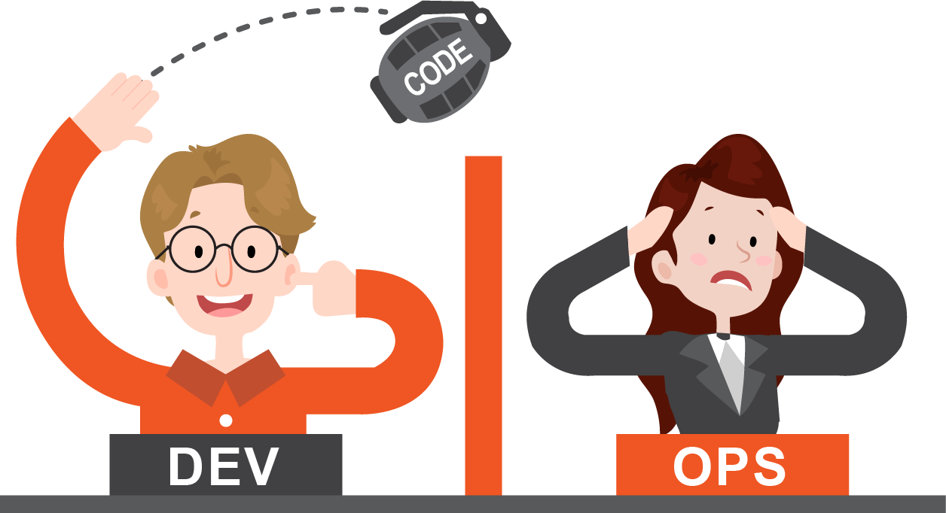
www.bcstechnology.com.au
Notes:
Pain Points

Slide 13
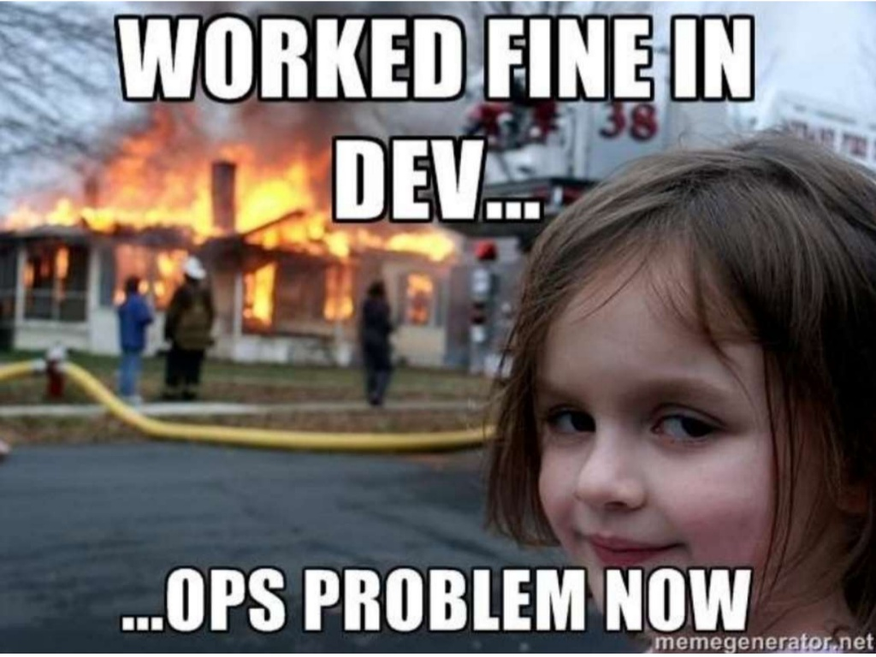
www.bcstechnology.com.au
Notes:
Pain Points

Slide 14
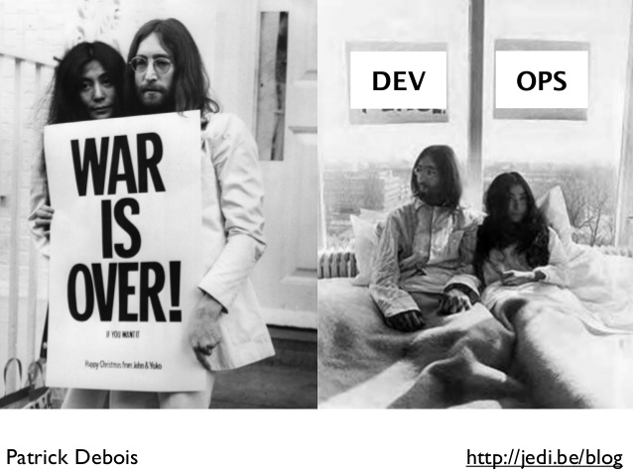
www.bcstechnology.com.au

Slide 15
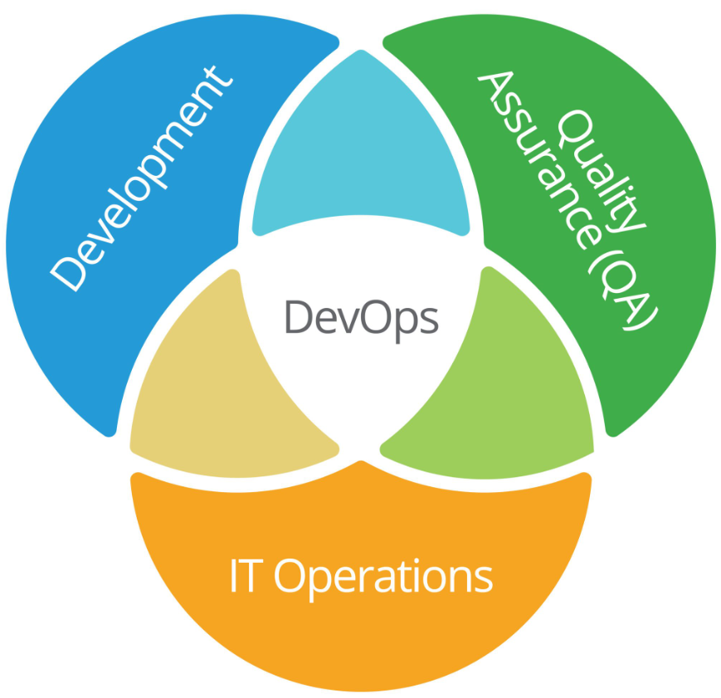

Slide 16

Case Study: Volaris
Notes:
Deployment from 10 hours to 5 mins.

Slide 17
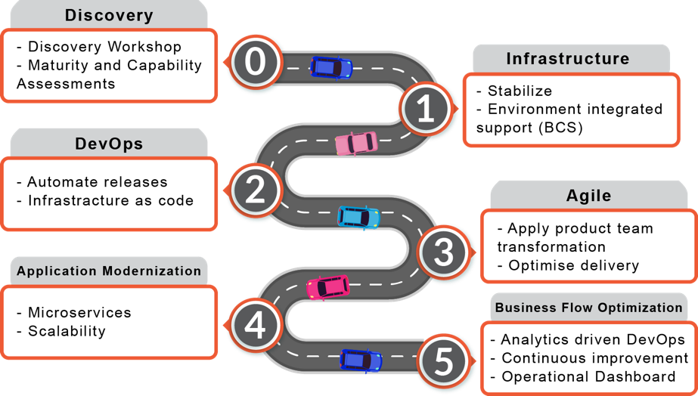

Volaris Roadmap
www.bcstechnology.com.au
Notes:
Approach

Slide 18
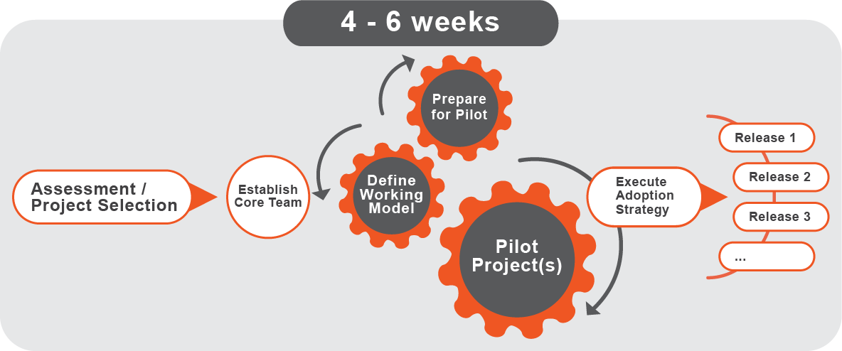
Volaris Approach
www.bcstechnology.com.au

Slide 19
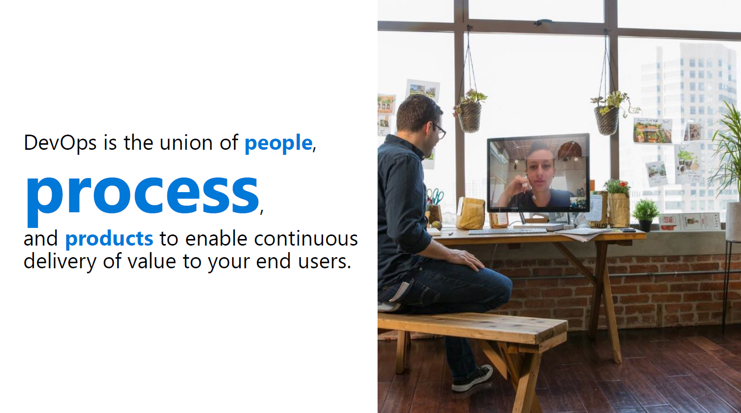

Slide 20
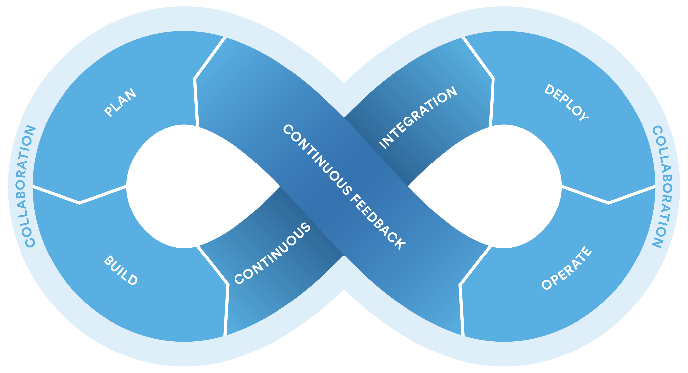
DevOps

Slide 21


Release Management
SOURCE REPO
DEV
Value
Optimized Resources
Accelerate Delivery
STAGE
Measure
Deployment Rate
MTTR
Availability
PRODUCTION
DEV
OPS

Slide 22

Continuous Integration
Source
Build
Value
Accelerate Delivery
Repeatability
Optimized Resources
Test
Measure
More frequent releases
MTTR
MTTD
DEV
OPS
OPS

Slide 23
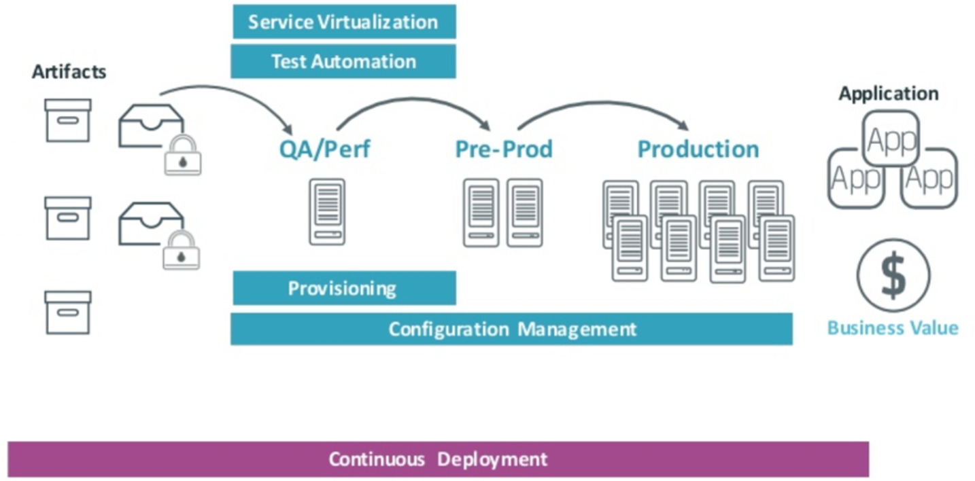
Continuous Deployment

Slide 24
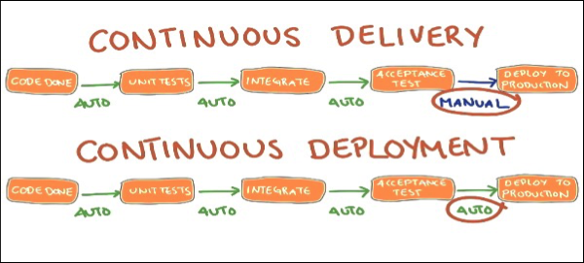
Continuous Delivery

Slide 25
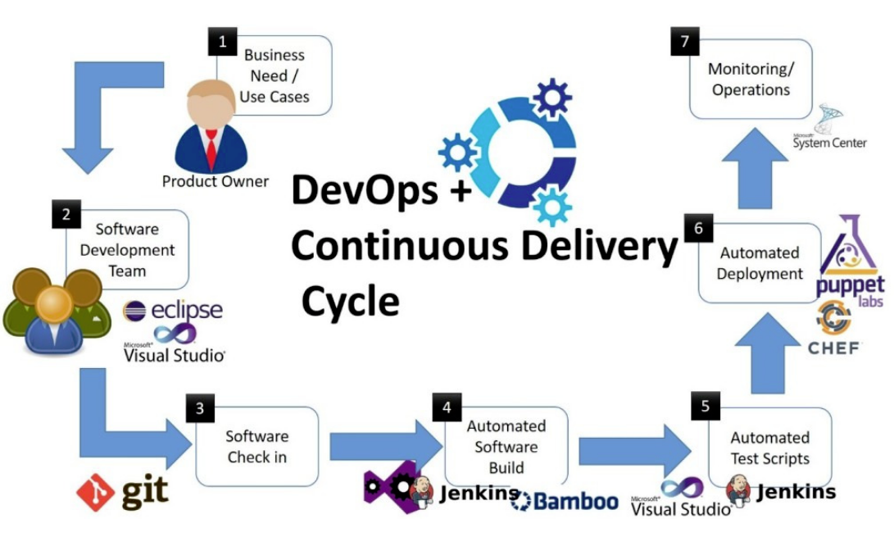
Software DevOps

Slide 26
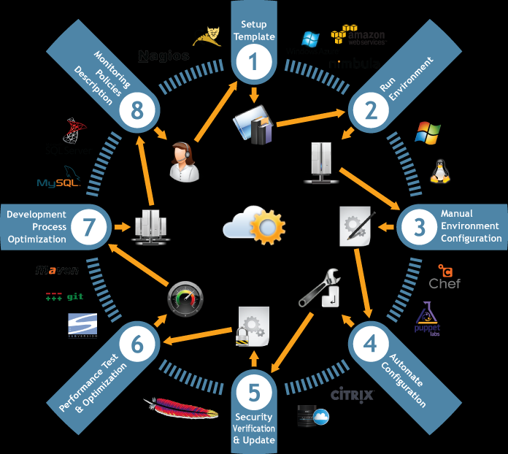
Infrastructure DevOps / Infrastructure as Code
Notes:
Terraform, pulumi, cloudformation templates, azure cli

Slide 27
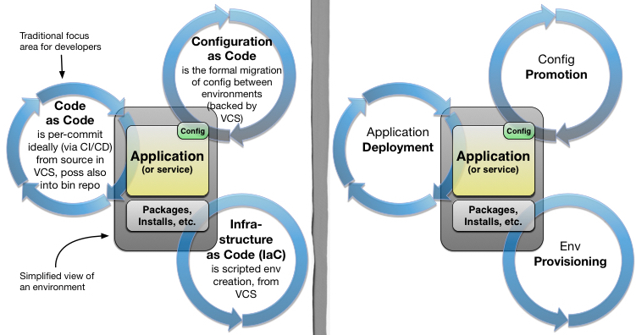
Configuration as Code
Notes:
DataOps has come to mean many things, quite a few of which are not SDLC related. The term is used in BI in deploying analytical models, data ingestion, analytics, and others. It’s not just devops for data
Related to DevOps however, our focus is on how to deploy new schemas on a live, online application without breaking it. We are going to look at some techniques.

Slide 28
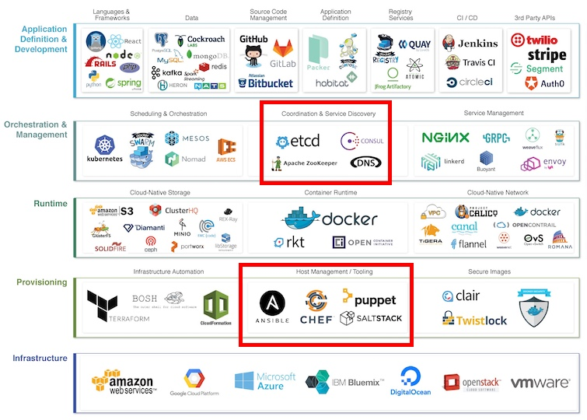
Configuration as Code
credit: DZone
Notes:
DataOps has come to mean many things, quite a few of which are not SDLC related. The term is used in BI in deploying analytical models, data ingestion, analytics, and others. It’s not just devops for data
Related to DevOps however, our focus is on how to deploy new schemas on a live, online application without breaking it. We are going to look at some techniques.

Slide 29
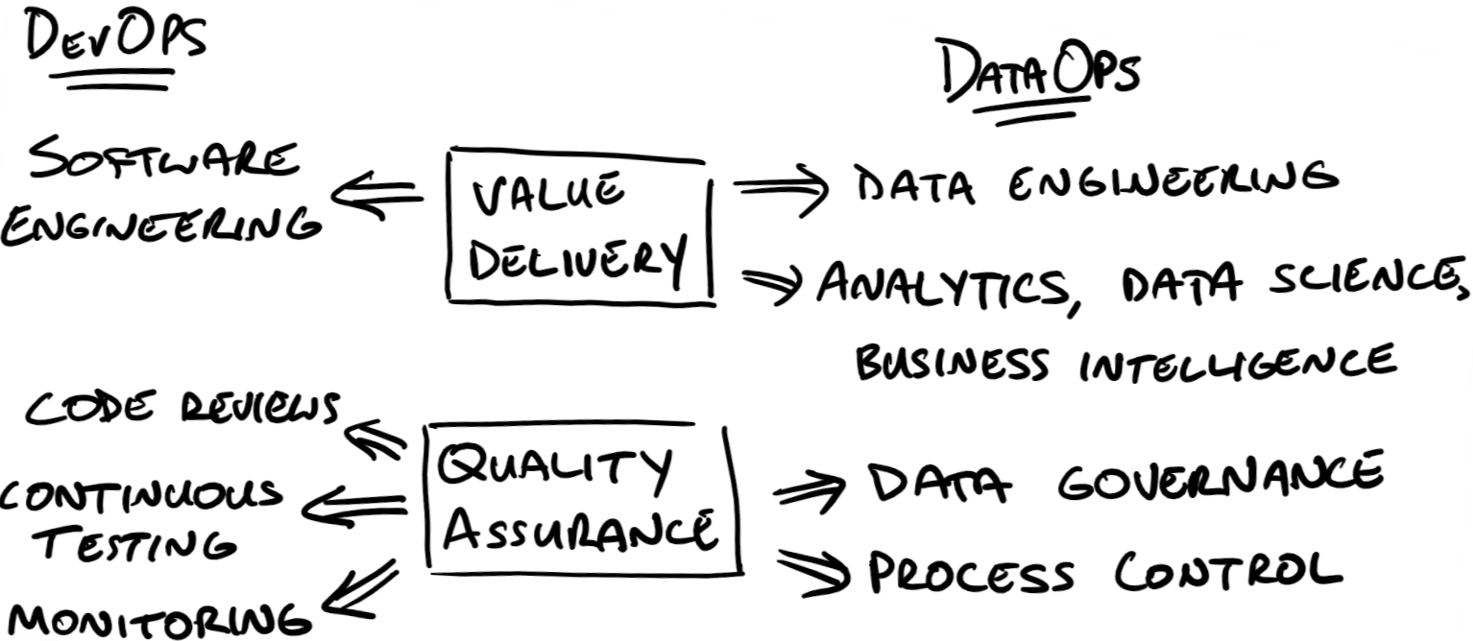
DataOps
Notes:
DataOps has come to mean many things, quite a few of which are not SDLC related. The term is used in BI in deploying analytical models, data ingestion, analytics, and others. It’s not just devops for data
Related to DevOps however, our focus is on how to deploy new schemas on a live, online application without breaking it. We are going to look at some techniques.

Slide 30
DataOps
Patterns:
Migration based deployment
State based deployment
Staggered Layer deployment
Data Layer = Roll forward Only
Deployment sequence planning

Slide 31
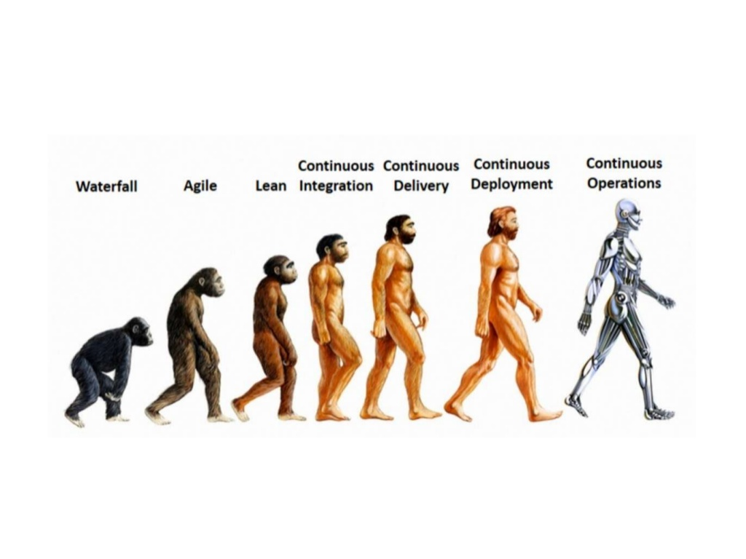

Slide 32
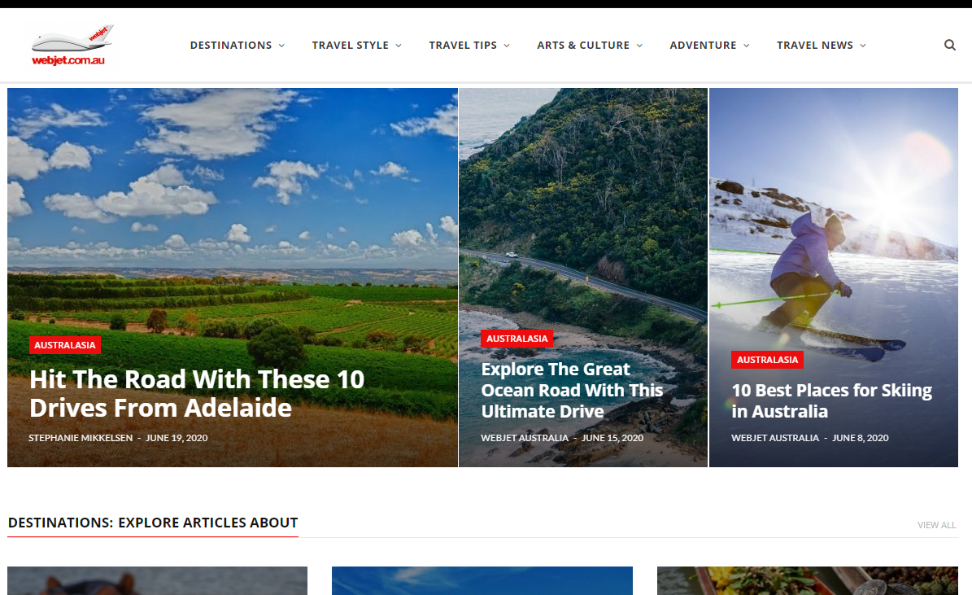
Case Study: Webjet
Notes:
They are targeting continuous deployment. A commit can potentially go straight to production.

Slide 33
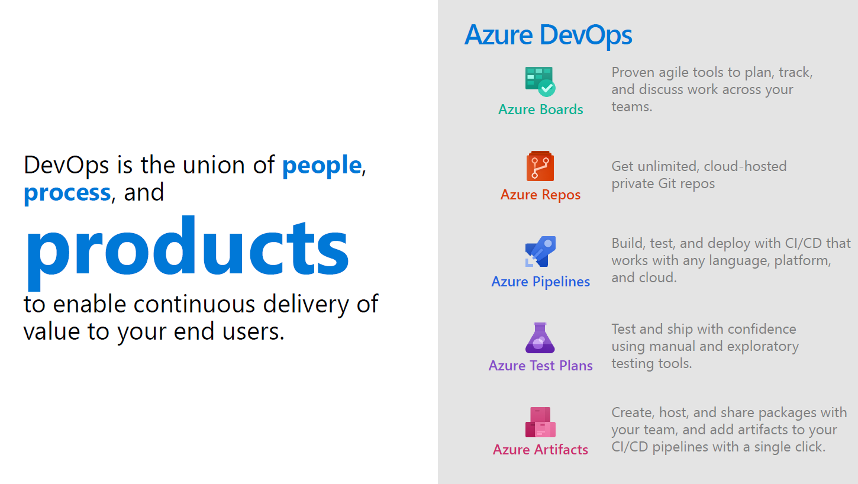

Slide 34
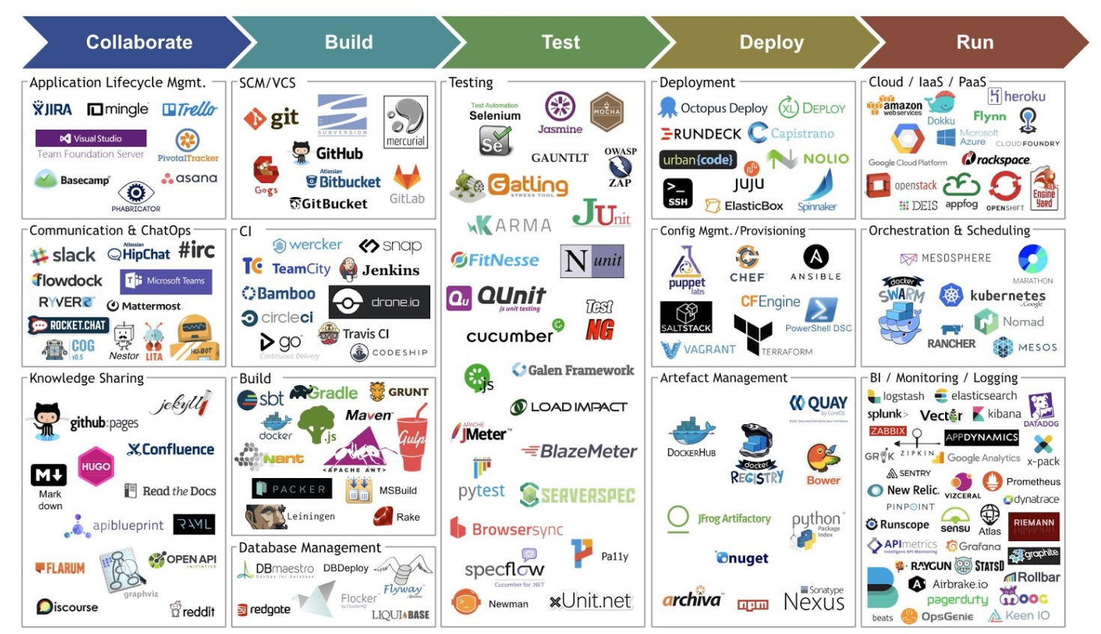

Slide 35











Microsoft DevOps solution
People | Process | Tools
Developer IDE
Build/CI
Release/CD
Develop
Build + Test
Monitor
Deploy
Team Collaboration
Release Management for Visual Studio
Test
Monitor + Learn
Automation Service
PowerShell | WAML
Azure Resource Management
Application Insights
Microsoft Test Manager
xPlat Command Line
On-Premises | Hybrid | Cloud

Slide 36







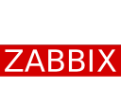


OSS DevOps
Solutions
People | Process | Tools
Developer IDE
Build/CI
Configuration
Develop
Build + Test
Monitor
Deploy
Team Collaboration
Release
Monitor + Learn
Test
On-Premises | Hybrid | Cloud

Slide 37

Case Study: Toyota Finance
Notes:
Deployment from 10 hours to 5 mins.

Slide 38

Microsoft Azure services drive advancement in loans origination system for Toyota Finance
“By serving as a platform for multifunctional assets, Microsoft Azure has enabled us to develop a solution that is authentic and highly flexible, with the agility purposed to drive applications required to perform core business operations.” – Richard Parhusip, Commercial Director, BCS Technology
MICROSOFT AZURE PARTNER:
BCS Technology International Pty. Ltd.
WEB SITE: www.bcstechnology.com.au
MICROSOFT AZURE MARKETPLACE: https://aka.ms/AA3tx64
LOCATION: Sydney, Australia
ORG SIZE: 300 employees
MICROSOFT AZURE PARTNER PROFILE:
BCS Technology is an award-winning global IT professional services company headquartered in Australia, with offices in India, Singapore, the Philippines, Canada, Jakarta, and Mexico. With more than 17 years of experience, BCS has a strong foundation in consulting, software development, project management, business intelligence, ERP, and UI design.
SITUATION
Toyota Finance wanted to replace its aging loans origination system with one that would enable dynamic loans calculation based on an analytical model. The new system would be used by all the car franchises. BCS was called on to provide a solution to “productionize” R models developed through machine learning algorithms to drive the company’s core business. The solution had to always be available and scalable based on dealer growth.
SOLUTION
BCS followed strategies involving microservices, DevOps, cross-regional durability, scalability, achieving zero downtime and fully automated whole environment provisioning to achieve an advanced loans origination system that would cater to Toyota Finance’s needs. By utilizing Microsoft Azure Application Gateway and Azure Traffic Manager, used by 500+ dealers, BCS was able to deploy its solution to production and roll out to 3,000 agents nationwide in Australia while operating with no downtime, even when the entire datacenter goes offline.
Through Azure DevOps and adhering to CI/CD ( Continuous Integration / Continuous Delivery), BCS completely automated the TFS Loans originating system
BENEFITS
Architecture provision for Self-healing apps and comprehensive use for proactive alerts that allow for little to no active monitoring required.
Azure Application Gateway significantly reduced costs as compared to using API management while performing the same required output.
Scalable application with Zero Downtime during deployments.

Slide 39

How to DevOps?

Slide 40
Keep in mind
Start small
Think of the process, not the tools
Store everything in github (or your choice of scc)
Have a staging environment and smoke test the hell out of it (automated if possible)
Do frequent deployments to prod (every sprint if possible, more frequent with multiple teams)
Automate the infrastructure too if possible (IAC)
Obviously, automate the deployment

Slide 41
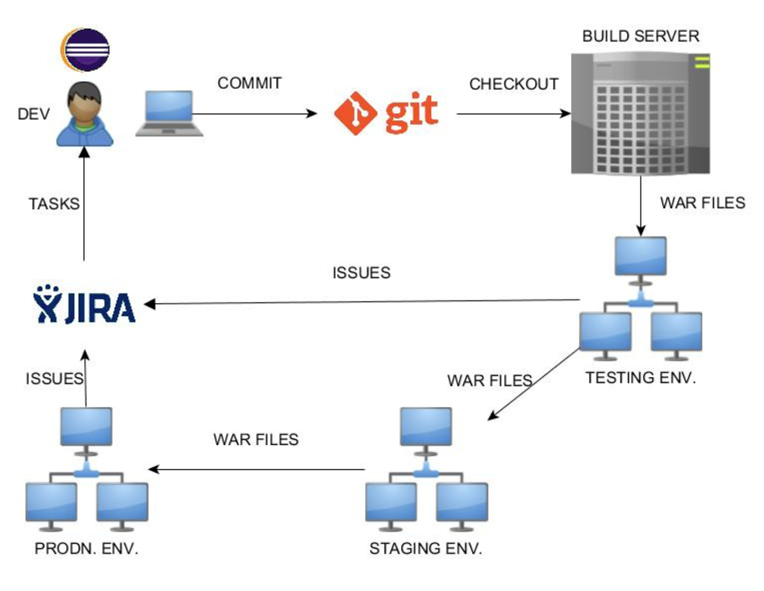

Slide 42
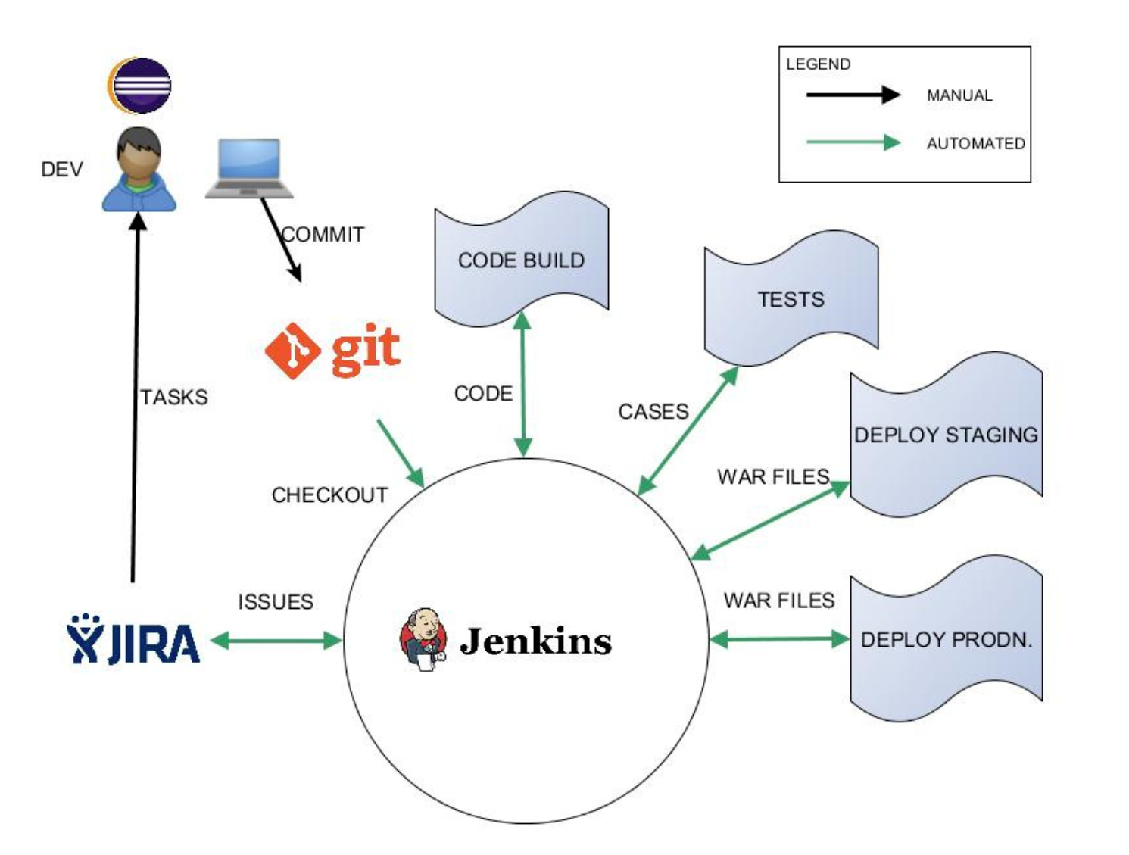

Slide 43
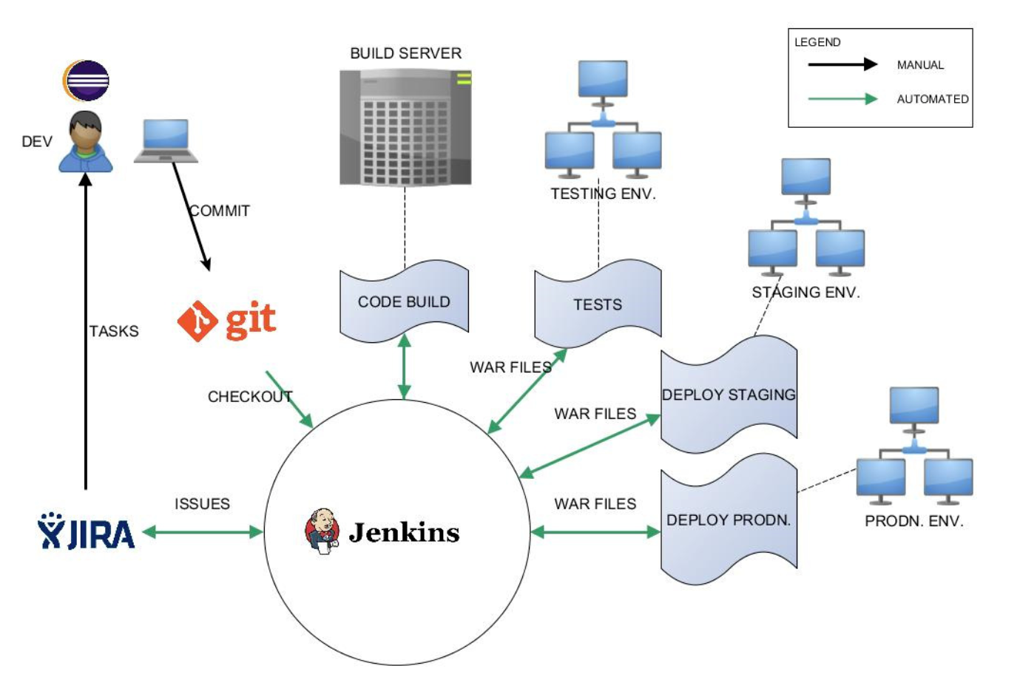

Slide 44
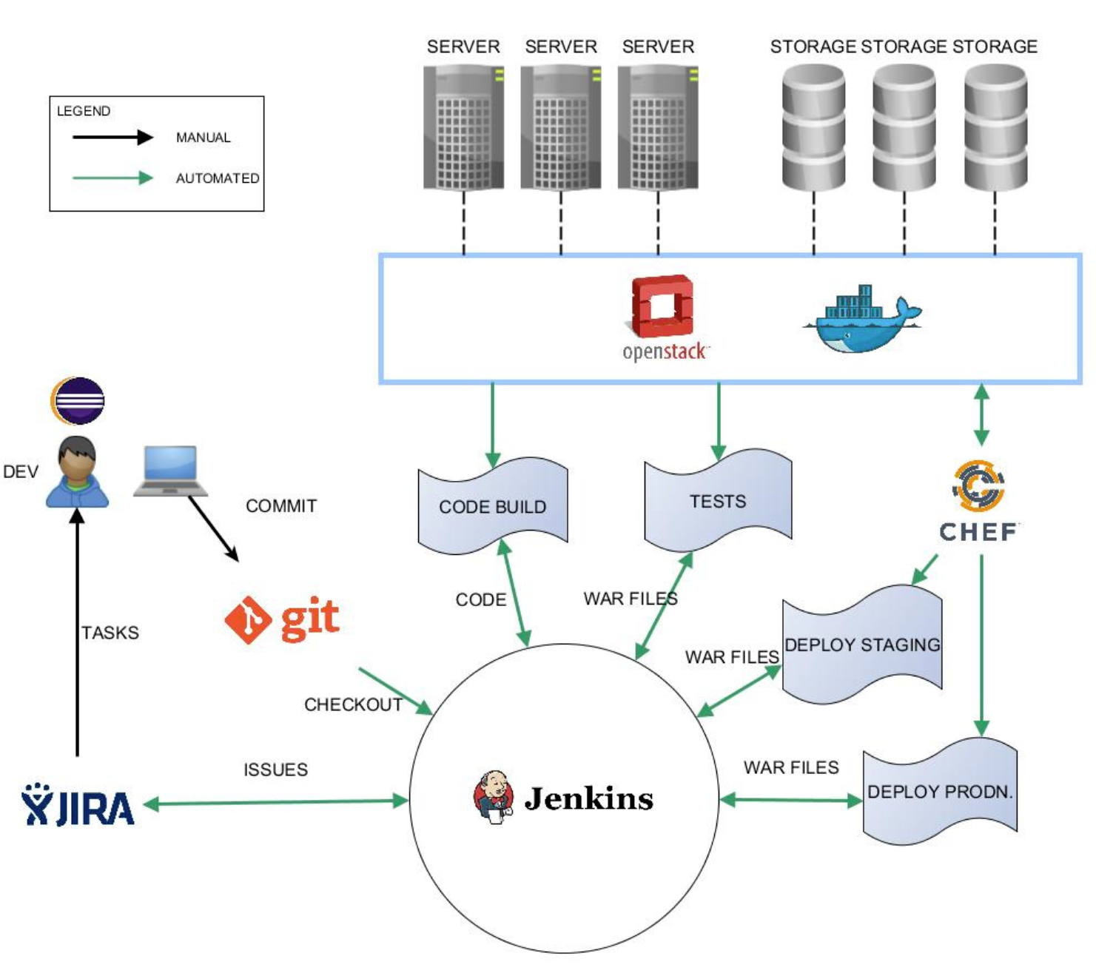

Slide 45
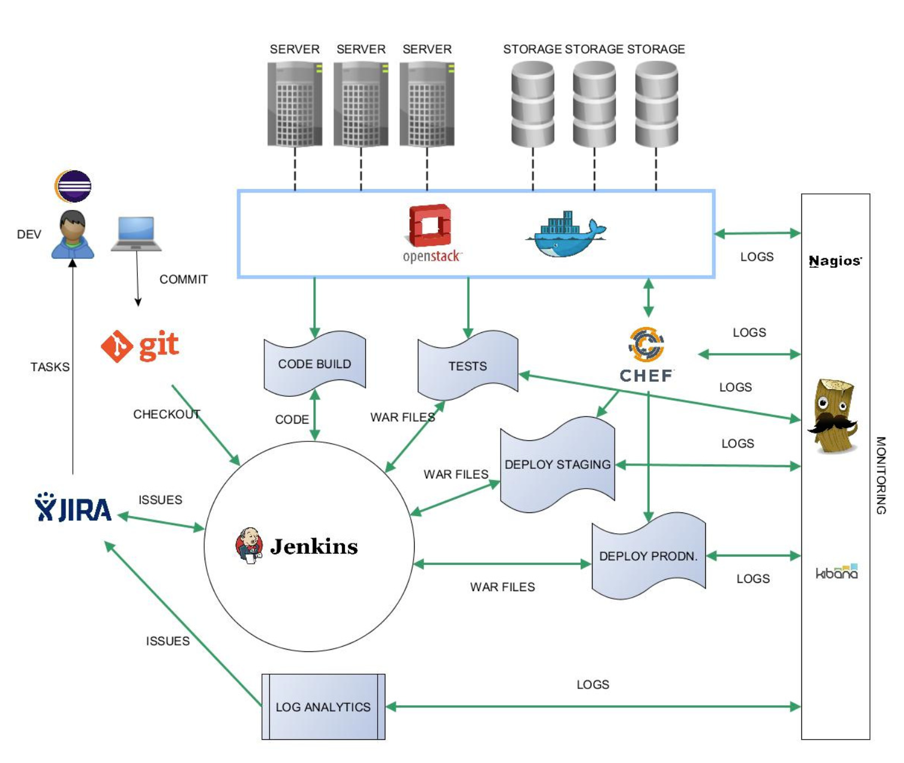

Slide 46
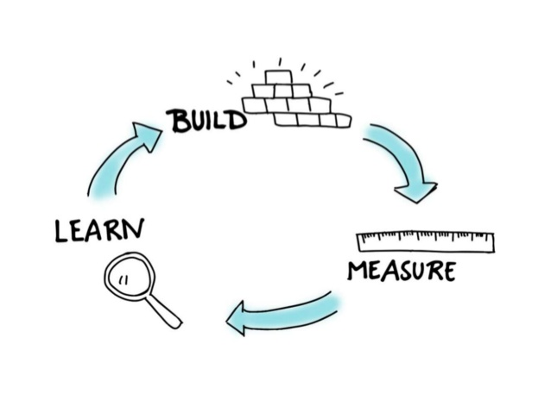

Slide 47
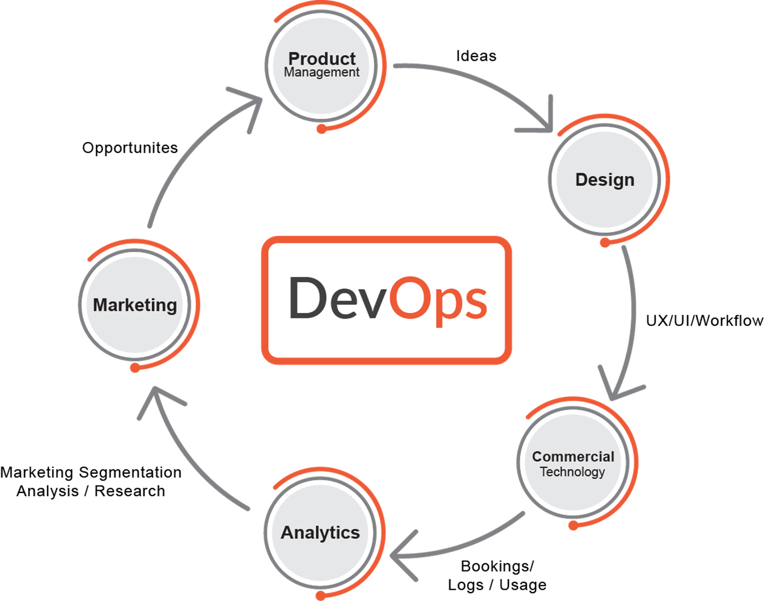

Slide 48
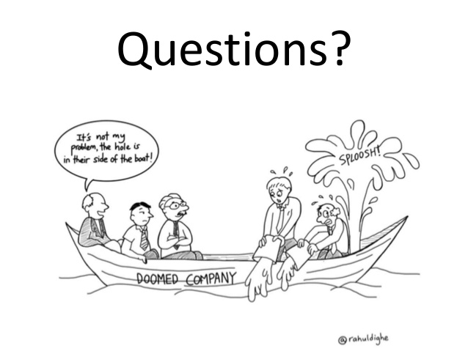
Thank You
Thank You

Slide 49
Thank you

